Slide 1

Hardware Asset Tracking (MDC ENTEC, Team Null Terminator)
Steve Hirabayashi, Julien Laurent,
Chris Girala, Shoaib Khan, Carlos Baltodano, Bernice Templeman
April 23, 2015
Notes:
This template can be used as a starter file for presenting training materials in a group setting.
Sections
Right-click on a slide to add sections. Sections can help to organize your slides or facilitate collaboration between multiple authors.
Notes
Use the Notes section for delivery notes or to provide additional details for the audience. View these notes in Presentation View during your presentation.
Keep in mind the font size (important for accessibility, visibility, videotaping, and online production)
Coordinated colors
Pay particular attention to the graphs, charts, and text boxes.
Consider that attendees will print in black and white or grayscale. Run a test print to make sure your colors work when printed in pure black and white and grayscale.
Graphics, tables, and graphs
Keep it simple: If possible, use consistent, non-distracting styles and colors.
Label all graphs and tables.

Slide 2
Outline
Current State (Problem)
Proposed Solution (Program)
Demo
Enhancements/Recommendations
Q&A

Slide 3

Current State (Problem)

Slide 4
Current State
Manual Process
Involves manual paperwork, notifications, & reports
Inventory
Manual tracking and input of inventory using tags
Time consuming, inefficient
Growing Need
Expanding technology scope for ENTEC dept
Requires frequent, increasing management of assets
Conflicts in reservations
No automated process for managing inventory including size and states
Requests from various campuses

Slide 5
Proposed Solution (Program)

Slide 6
Solution
Automated Process
Smart Asset Management
Reports
ENTEC faculty utilize console program to handle borrow/reservation requests from users from any campus
States of assets recorded and taken into account before and after rentals
Generate desired reports such as active rentals, reservation requests, incidents, and total inventory
Detailed user info for rentals recorded
Add/update entire inventory

Slide 7
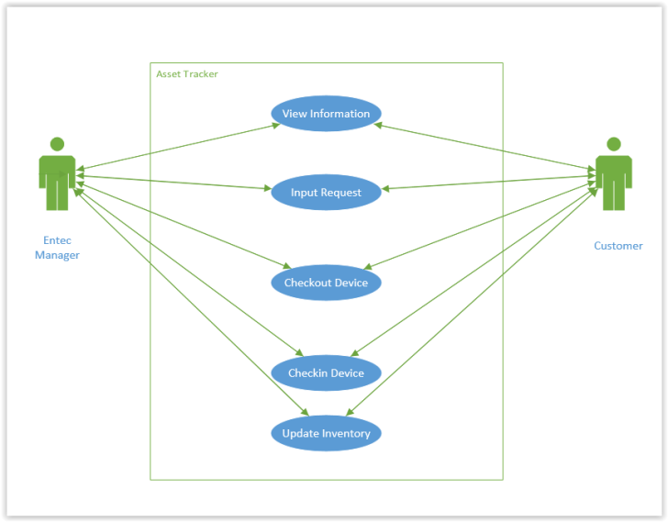
Solution

Slide 8
Demo

Slide 9
Future Enhancements/ Recommendations

Slide 10
Enhancements/Recommendations
Hardware
Utilize hardware scanner for asset tags
Utilize RFID tags with GPS transceivers
Mobile App
Port solution into a mobile application
Utilize NFC/Bluetooth to scan tags
Storage
Encrypt user info for security
Utilization of cloud storage for flexibility in access and backup

Slide 11
Questions?

